Slide 1
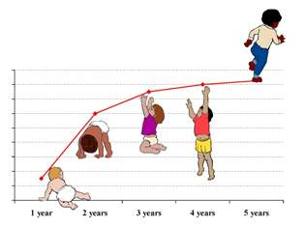
Child growth and development

Slide 2
Learning objectives
By the end of this lecture, the student will be able to:
Define growth and development.
Outline the principles of growth and development.
Identify the importance of growth and development.
Describe factors affecting growth and development.
List types of growth and development.
Identify the stages of development.

Slide 3
Introduction
Growth and development begins at conception and ends at maturation
Growth; Increase in size and weight of the whole body or any of its parts due to increase in number and size of cells.
It is simply a quantitative change in the child’s body.
Development; increase in complexity and capacity to function optimally in the society
It is a qualitative change in the child’s functioning
Maturation; Increase in child’s competence and adaptability
It is the qualitative change in the child’s overall growth and development

Slide 4
Differences between growth and development
Growth | Development
Term used purely in physical sense, it generally refers to increase in size, length i.e. changes in the quantitative aspects. | Implies overall change in shape, form or structure resulting in improved working or functioning, changes in the quality or character rather than the quantitative
Does not continue throughout life. It stops when maturity has been attained. | It continues throughout life and is progressive.
The changes produced by growth are the subject of measurement. They may be quantified | Implies improvement in functioning and behavior and hence brings qualitative changes. Difficult to measure directly. Assessed by observation of behavior.

Slide 5
Stages of growth and development
Pre- natal; conception- birth
Germinal: conception – 2 weeks
Embryonic: 2- 8 weeks
Fetal: 8-40 weeks
Infancy
Neonate: 0- 28 days
Infancy: 1 month-1 year
Early childhood
Toddler:1-3 years
Pre-school: 3-6 years
Middle childhood
School age: 6-12 years
Late childhood
Adolescence
12 – app. 18 years.

Slide 6
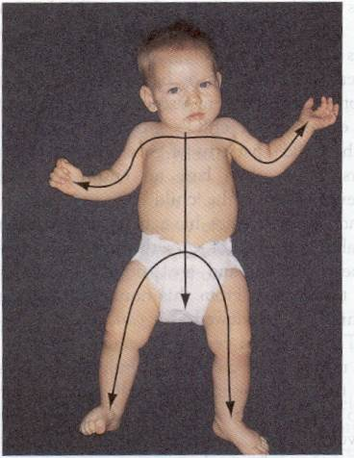
Principles of growth and development
Continuous, occurs in a sequential process; predictable and follows a universal timetable
Directional; skill development proceeds along different pathways;
Cephalocaudal(head to toe)
Proximal distal (inward- outward)
General to specific
Simple to complex
Wide individual difference in growth and development

Slide 7
Principles cont…
Hierarchical integration; Skills develop separately and independently thereafter, are integrated into more complex skills
Growth and development is not uniform throughout life; there are periods of accelerated and decelerated growth (growth spurts).
New skills pre-dominate; strong drive to practice and perfect new abilities, especially early in life.
Notes:
D into more comlex

Slide 8
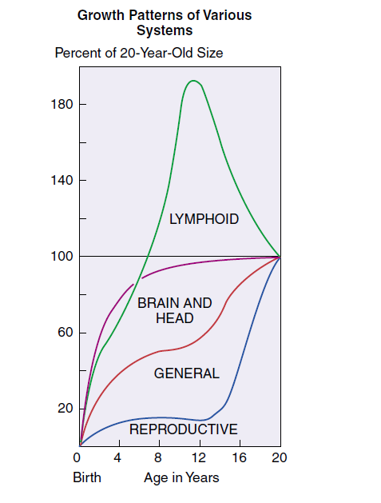
Rates and patterns of growth are specific to certain parts of the body; different body tissues and systems mature differently

Slide 9
Development is interrelated; physiological, psychosocial, cognitive and moral aspects of development are affected by one another
Each stage of G&D is affected by the preceding types of development

Slide 10
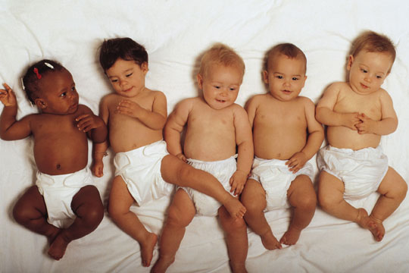
Importance of understanding growth and development to the nurses
Help the nurse provide screening for physical and emotional problems.
Gaining better understanding of the reasons behind illnesses.
Helping in formulating the plan of care.

Slide 11
Develop a rapport with the child to enhance the provision of health care;
Anticipatory guidance and teaching to parents in order to achieve optimal growth & development at each stage
Provide education to the family to build a healthy lifestyle for the future.

Slide 12
Factors affecting growth and development:
Hereditary
Environmental factors
Pre-natal environment
1. Factors related to mother during pregnancy:
- Nutritional deficiencies
- Obstetric disorders of pregnancy; Chronic medical conditions
- Exposure to radiation
- Torch infections
- Drug and substance use
2. Factors related to the fetus
Mal-position in uterus
Faulty placental implantation
Multiple pregnancy

Slide 13
Post-Natal Environment
External environment:
- socio-economic status of the family
- child’s nutrition
- climate and season
- child’s ordinal position in the family
- Number of siblings in the family
- Family structure (single parent or extended family … )
Cultural factors
Child’s internal environment
Child’s health status
Child’s intelligence
Hormonal influences
Emotional factors

Slide 14
Types of growth and development
Types of growth:
- Physical growth (Ht, Wt, head & chest circumference)
- Physiological growth (vital signs …)
Types of development:
- Motor development
- Cognitive development
- Emotional development
- Social development

Slide 15
Development assessment
Developmental assessment is an integral part of the pediatric examination and assessment
Mainly done by assessing milestones; children accomplish maturation of different biological functions at anticipated age, with margin of a few months on either side
Requires practice and skill.
Systematic in approach to ensure all areas of development are covered
Developmental assessment is divided into four major areas:
Gross motor; control of child over his body
Fine motor; coordination of eyes, hand-eye coordination, hand – mouth coordination and skills for manipulation with hands
speech and language,
Social.
Delay in all four indicates intellectual disability, isolated delay in any one area is often not abnormal.

Slide 16
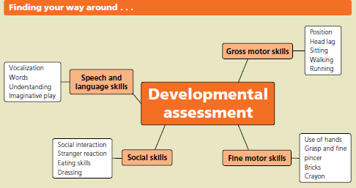
Development assessment

Slide 17
Newborn growth & development
Physical growth
Birth weight; 2.700 – 4 kg
1st week of life: baby looses 5-7% of birth weight which should be regained by 10th day of birth. Weight loss is due to;
Withdrawal of hormones from mother.
Loss of excessive extra cellular fluid.
Passage of meconium (feces) and urine.
Limited food intake
From 10th day- 1month
Growth rate for males- 40 g/kg/day
Growth rate for females- 35 g/kg/day
Gain ¾ kg by the end of the 1st month

Slide 18
Physical growth cont…
Height
Boys average Ht = 50 cm
Girls average Ht = 49 cm
Normal range for both (47.5- 53.75 cm)
Head circumference
33-35 cm
Head is ¼ total body length
Skull has 2 fontanels (anterior & posterior)
Chest circumference
It is 30.5 to 33cm (usually 2–3cm less than head circumference).

Slide 19
Motor development
Gross motor development
The newborn's movement are random, diffuse and uncoordinated. Reflexes carry out bodily functions and responses to external stimuli.
Eyes follow bright moving objects.
Lies awake on back.
Responds to sounds of bell and other similar noises
Fine motor development
Holds hand in fist
Immediately drops objects placed in hands.
When crying, he draws arms and legs to body
Reflexes
Swallowing
Gagging
Sucking
Grasp
Rooting
Step reflex

Slide 20
Cognitive development
Refers to the development of thinking, gaining and using knowledge.
Reflexive
Learning occurs through imitation and habituation- ability to decrease response to disturbing stimuli.
Newborns at age 12 can be able to imitate facial and manual gestures of adults
The newborn infant responds to sounds with either cry or eye movement, cessation of activity and / or startle reaction
Sensitive to touch and handling; It is the most highly developed sense. It is mostly at lips, tongue, ears, and forehead.

Slide 21
Responses are generally limited to tension states or discomfort.
Gains satisfaction from feeding and being held, rocked, fondled, and cuddled.
Taste; well developed as bitter and sour fluids are resisted while sweet fluids are accepted.
Smell; only evidence in newborn infant’s search for the nipple, as he smell breast milk.
Social Development
Intently regards face of mother
Respond to auditory stimulus by turning head and looking at the source of the stimuli.

Slide 22
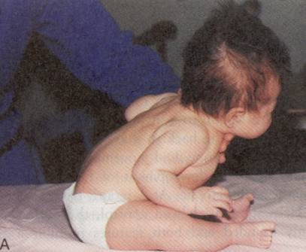
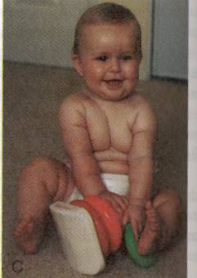
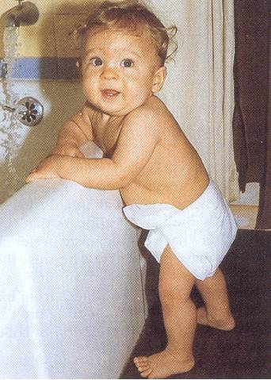
Infancy
It is the period which starts at the end of the first month up to the end of the first year of age.
Infant's growth and development during this period is rapid
2 months 6 months 12 months

Slide 23
Physical Growth in Infancy
Weight : the infant gains :
- Birth to 4 months → ¾ kg /month
- 5 to 8 months → ½ kg / month
- 9 to 12 months → ¼ kg /month
The infant will double his birth wt by 4-5 months and triple it by 10-12 months of age
Approximation of Infant weight from 3 to 12 months
Weight = Age in months + 9
2
Example; Wt of 7 months old infant = 7+9 = 16 = 8 kg
2
Length increases by 50% in first year
Length increases about 3 cm /month during the 1st 3 months of age,
then it increases 2 cm /month at age of 4-6 months,
Then, at 7 – 12 months, it increases 1 ½ cm per month

Slide 24
Physical growth cont…
Head circumference;
It increases about 2 cm /month during the 1st 3 months,
Then, ½ cm/month during the 2nd 9 months of age.
By 12 months, the infant’s brain will be 2/3 the size of an adult’s
Posterior fontanelle closes at approximately 4 months
Chest circumference
By the end of the 1st year, it equals head circumference.

Slide 25
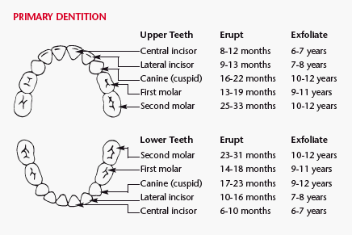
Physical growth cont…

Slide 26
Motor development
Gross motor development
At 2 months
Turn heads from side to side.
Reflexive behavior is slowly being replaced by voluntary movements.
Begins to lift head momentarily from prone position.
Shows eye coordination to light and objects.
If bell is sounded nearby, infant will stop activity and listen.
Eyes follow better, both vertically and horizontally. Focuses well.

Slide 27
At 3 months
Hold head erects and steady.
Open or close hand loosely.
Hold object put in hand
4 months
Can lift head and shoulders, head control achieved
Hold head erect and steady while in sitting position.
Bring hands together in midline and plays with fingers.
Grasp objects with both hands.

Slide 28
At 3 months
Hold head erects and steady.
Open or close hand.
Hold object put in hand
4 months
Can lift head and shoulders, head control achieved
Hold head erect and steady while in sitting position.
Bring hands together in midline and plays with fingers.
Grasp objects with both hands.

Slide 29
Gross motor development cont…
5 months; rolls over, sits with support
6 months ;sits without support, bear weight on legs
9 months, the baby can get into the sitting position alone, stands alone with support .
Mobility.
Crawling at 7–9 months, some babies don’t pass through the crawling phase. Others bottom shuffle.
Pulling up to standing occurs at 10 months
Cruising occurs by 11 months.
12–13 walks independently variable.
15 months stands from crouching

Slide 30
Fine motor development
Require dexterity and cognitive ability.
2 months, grasp reflex fades, grasps and momentarily holds objects before dropping, hands held open.
3 months; laces fingers in the mouth, holds a rattle and shakes.
5 months; voluntary palmer’s grasp, reach out for a toy.
6 months, transfers object from one hand to the other.
7 months, grasp an object and bring it to the mouth.
9 months pincer grasp, emergence of dominant hand
1 year, a baby will give a 2-cm square wooden block
to you and release it.
Turns multiple pages of a book

Slide 31
Speech & language
Vocalizes at about 3 months and starts to enjoy playing with his voice.
6 months; makes consonant sounds such as ‘da’, ‘ba’, ‘ma’ and ‘ka’.
8 months; ‘double babble’ (dada, baba, mama).
10 months; understand spoken speech and responds in appropriate manner
12 months and two or three words with meaning for objects of daily use (True speech).

Slide 32
Social skills
Refers to child interaction with people, and acquisition of everyday skills such as eating and dressing
Sights and sounds are the most important stimuli that elicit reactions in a baby.
4 weeks; quietens to speech, or opens their eyes widely in response spoken word.
6 weeks; smiles responsively, major milestone. Failure to smile by 8 weeks is abnormal.
3 months; squeals with pleasure, recognizes mother
4 months; Gastrocolic reflex disappears, discriminates between strangers and familiar people.

Slide 33
6 months; Play is self-contained, Laughs out loud, makes “talking” sounds in response to others' talking.
8 – 10 months; Begins fear of strangers.
‘Permanence of objects’ develops on average by 9 months – prior to this age, a baby shows no reaction when an object is dropped from view
Waves ‘bye bye’
10 months appreciates phrases such assays ‘no’.
12 months; separation anxiety.
12 months; mimics action carried out by mother

Slide 34
Cognitive development
Becomes alert when mother is around, 2-3 months
Reaches for dropped toy by 8 months
Loves peek- a boo game by 10 months

Slide 35
Toddler growth and development
Toddler stage is between 1-3 years of age. Growth slows down considerably
Physical growth
Weight:
The toddler's average weight gain is 1.8 to 2.7 kg/year.
Formula to calculate normal weight of children over 1 year of age is
Age in years X 2+8 = ….. kg.
e.g., The weight of a child aging 4 years
= 4 X 2 + 8 = 16 kg

Slide 36
Physical growth cont…
Height
During 1–2 years, the child's height increases by 1cm/month.
The toddler's height increases about 10 to 12.5cm/year.
Estimation of height
Age in years X 5 + 80 = cm.
e.g., the length of 2 years old child
= 2 X 5 + 80 = 90cm
Head & chest circumference
The head increases 10 cm only from the age of 1 year to adult age.
During toddler years, chest circumference continues to increase in size and exceeds head circumference.
Teething
By 2 years of age, the toddler has 16 temporary teeth.
By the age of 30 months (2.5 years), the toddler has 20 teeth

Slide 37
Motor development
Gross motor development
15 months
Walks alone, creeps upstairs,
Assume standing position without falling.
Hold a cup with all fingers grasped around it.
At 18 months:
Hold cup with both hands.
Transfer objects hand-to hand at will.
child scribbles with a crayon and can turn the pages of a book
Go up and down stairs alone with two feet on each step.
At 24 months:
Hold a cup with one hand.
Remove most of own clothes.
Drink well from a small glass held in one hand.
2-3 years
2 dimension diagram

Slide 38
30 months:
Jump with both feet.
Jump from chair or step.
Walk up and downstairs, one foot on a step.
Drink without assistance
Fine Motor development
1 year old: transfer objects from hand to hand
2 year old: can hold a crayon and color vertical strokes
Turn the page of a book
Build a tower of six blocks
3 year old: copy a circle and a cross – build using small blocks

Slide 39
Social development
Stranger anxiety – should dissipate by age 2 ½ to 3 years
Temper tantrums: peak incidence 18 months – most disappear by age 3
Sibling rivalry: aggressive behavior towards new infant: peak between 1 to 2 years but may be prolonged indefinitely
Thumb sucking
Toilet Training15 months, can drink from a cup and use spoon to eat.
24 months; indicates toilet needs, with toilet training by day usually achieved by 2 1/2 years
Help with dressing by holding out an arm or leg at 1 year, and by 3 dress and undress independently
Engage in parallel play

Slide 40
Language development
Jargon (unintelligible but highly expressive ‘language’) develops at about 15 months of age.
By 18 months, the average child has 10–20 recognizable words
24 months words linked into two-word sentences.
3 years the child can form full sentences and talks incessantly
Cognitive development
3 years; Able to categorize similar objects such as animals, vehicles etc
4 years; counts sequentially
5 years; identifies five different colors
Moral development

Slide 41
PRE-SCHOOL
Physical growth:-
Weight: The preschooler gains approximately 1.8kg/year.
Height: He doubles birth length by 4–5 years of age.
Acquires more posturally erect contour
Visual acuity reaches 20/20
More organized sleep patterns
Gross motor
Walking, running and jumping is well established
Can stand in one foot for a short time, skips on alternate feet, walk on heels
Catch ball with two hands

Slide 42
Fine Motor Development
4 year old: use scissors, color within the borders
5 year old: write some letters and draw a person with body parts
Buttoning clothing
Holding a pencil
Building with small blocks
Playing a board game
Have child draw picture of himself
5 year old; attempts to tie shoe lace

Slide 43
Social & Emotional Development of Preschooler
Fears the dark
Tends to be impatient and selfish
Expresses aggression through physical and verbal behaviors.
Shows signs of jealousy of siblings.
Egocentric
Tolerates short separation
Less dependant on parents

Slide 44
May have dreams & night-mares
Attachment to opposite sex parent
More cooperative in play
Starts to learn right from wrong
Becomes less rebellious and quarrelsome
Understand sex-role functions

Slide 45
school-age
Characterized by gradual growth.
Physical growth
Weight:
School–age child gains about 3.8kg/year.
Boys tend to gain slightly more weight through 12 years.
Weight Formula for 7 - 12 yrs
= (age in yrs x 7 )– 5
2
Height:
The child gains about 5cm/year.
Body proportion during this period: Both boys and girls are long-legged.
Dentition:
Permanent teeth erupt during school-age period, starting from 6 years, usually in the same order in which primary teeth are lost.
The child acquires permanent molars, medial and lateral incisors.

Slide 46
School Years: Motor development
Gross motor
Balancing, catching, throwing, jumping and climbing becomes refined
Fine motor
Fine motor is refined
Writing skills improve
Fine motor with more focus
Building: models – logos
Sewing
Musical instrument
Painting
Typing skills
Technology: computers

Slide 47
Motor development
At 6–8 years, the school–age child:
Rides a bicycle.
Runs Jumps, climbs and hops.
Has improved eye-hand coordination.
Prints word and learn cursive writing.
Can brush and comb hair.
8 to 10 years: team sports
Age ten: match sport to the physical and emotional development

Slide 48
At 8–10 years, the school–age child:
Throws balls skillfully.
Uses to participate in organized sports.
Uses both hands independently.
Handles eating utensils (spoon, fork, knife) skillfully.
At 10–12 years, the school–age child:
Enjoy all physical activities.
Continues to improve his motor coordination.

Slide 49
Emotional development
The school–age child:
Fears injury to body and fear of dark.
Jealous of siblings (especially 6–8 years old child).
Curious about everything.
Has short bursts of anger by age of 10 years but able to control anger by 12 years.
Continues to be egocentric.
Wants other children to play with him.
Insists on being first in every thing
Becomes peer oriented.
Has greater self–control, confident, sincere.
Respects parents and their role.
Joins group (formal and informal).
Engage in tasks in the real world.

Slide 50
Red flags: school age
School failure
Lack of friends
Social isolation
Aggressive behavior: fights, fire setting, animal abuse

Slide 51
Adolescent age
Adolescence is a transition period from childhood to adulthood.
Physical growth
Physiological growth
Secondary sex characteristics
Cognitive development
Emotional development
Social development

Slide 52
Physical growth:
Weight:
Growth spurt begins earlier in girls (10–14 years, while it is 12–16 in boys).
Males gains 7 to 30kg, while female gains 7 to 25kg.
Height:
By the age of 13, the adolescent triples his birth length.
Males gains 10 to 30cm in height.
Females gains less height than males as they gain 5 to 20cm.
Growth in height ceases at 16 or 17 years in females and 18 to 20in males

Slide 53
Social & emotional development
As teenagers gain independence they begin to challenge values
Critical of adult authority
Relies on peer relationship
Mood swings especially in early adolescents
Emotional development:changes in emotional control, exhibits alternating and recurrent episodes of disturbed behavior with periods of quite one. He may become hostile or ready to fight, complain or resist every thing.

Slide 54
Social development: develops a sense of identity. If the adolescent is unable to formulate a satisfactory identity from the multi-identifications, sense of self-confusion will be developed
Adolescent shows interest in other sex.
He looks for close friendships.

Slide 55
Red Flags development
Infancy
Unable to sit alone by age 9 months
Unable to transfer objects from hand to hand by age 1 year
Abnormal pincer grip or grasp by age 15 months
Unable to walk alone by 18 months
Failure to speak recognizable words by 2 years.
Toddler
Pre-school
Inability to perform self-care tasks, hand washing simple dressing, daytime toileting
Lack of socialization
Unable to play with other children
Unable to follow directions during exam

Slide 56
Red flags Cont….
School age
School failure
Lack of friends
Social isolation
Aggressive behavior: fights, fire setting, animal abuse

Slide 57
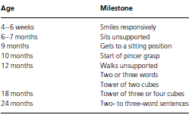
Essential milestones

